Slide 1
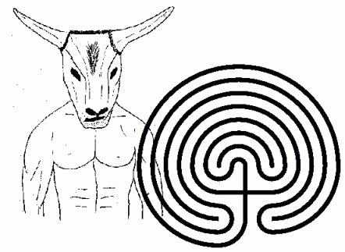


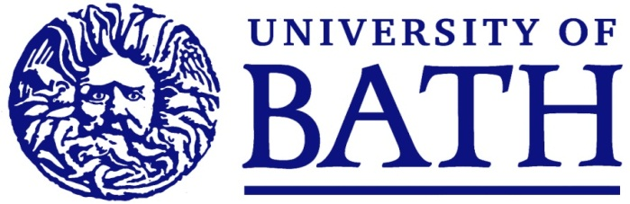
Great Mathematical Myths
Chris Budd

Slide 2
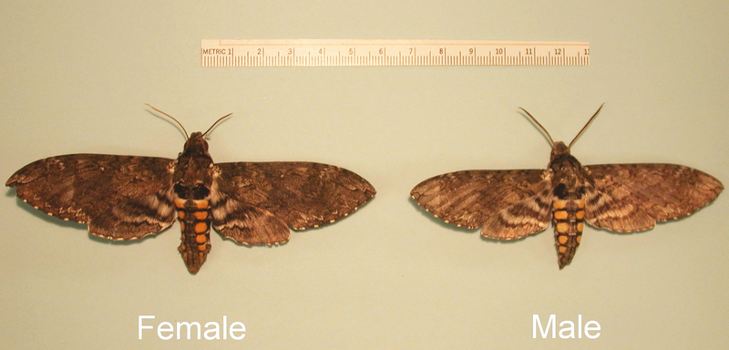
A myth is a female moth
Student Bloopers

Slide 3
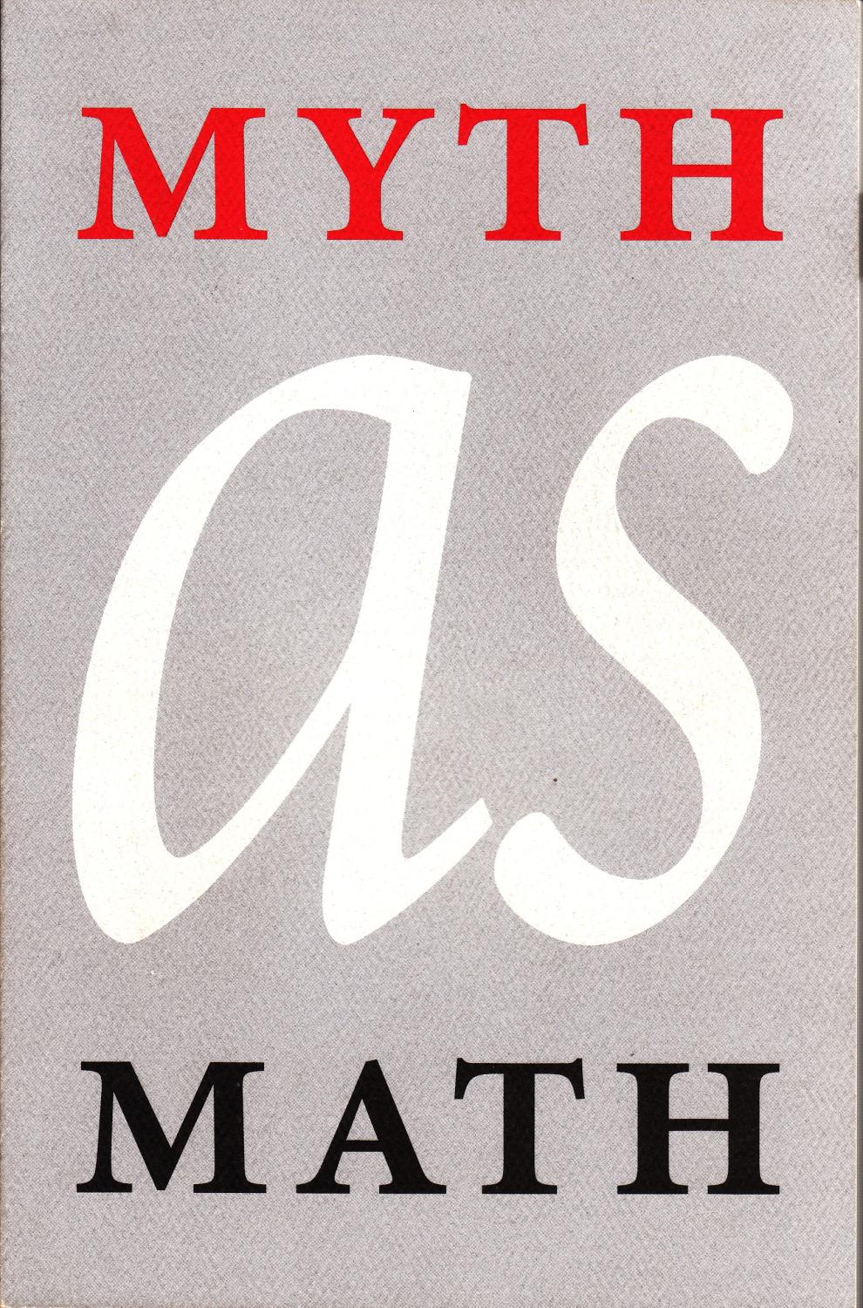
When we think of Maths, we tend
not to think of Myths
Myths are the stuff of legend
and wonder
Maths on the other hand, is coldly logical and has no room for doubt and error!
Or does it?

Slide 4
A mathematical truth, through retelling, an lack of understanding, enters the public consciousness as a myth rather than a truth
Especially the case if this satisfies some underlying need for some order and pattern in life, the universe, and everything
A great shame as mathematical truths are far more exciting and surprising than any myth, and give much insight into the way that the universe works

Slide 5
Myths about maths

Slide 6
Theseus and the Minotaur

Slide 7
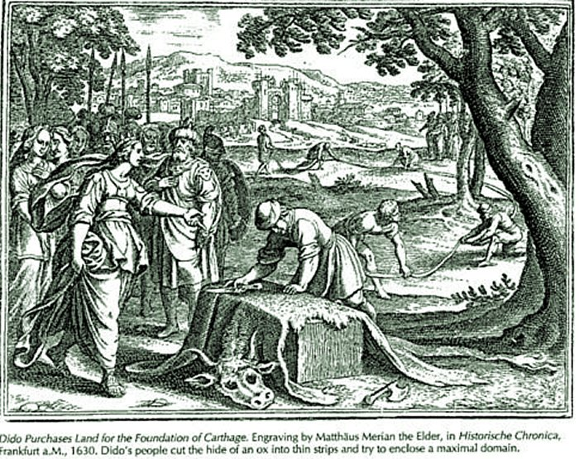
Dido of Carthage

Slide 8
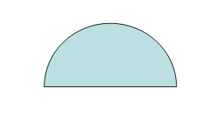
Iso-perimetric theorem

Slide 9
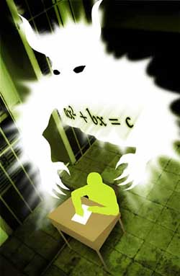
The scary maths myth

Slide 10
Mathematical myths

Slide 11
The Golden Ratio

Slide 12
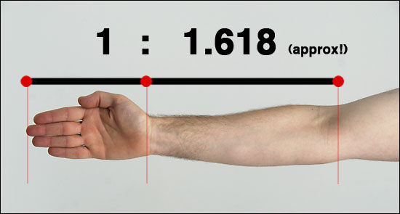
The claim …
The Golden Ratio is a Divine Proportion

Slide 13
According to Mario Livio
Some of the greatest mathematical minds of all ages, from Pythagoras and Euclid in ancient Greece, through the medieval Italian mathematician Leonardo of Pisa and the Renaissance astronomer Johannes Kepler to present-day scientific figures such as Oxford physicist Roger Penrose have spent endless hours over this simple ratio and its properties. ... Biologists, artists, musicians, historians, architects, psychologists, and even mystics have pondered and debated the basis of its ubiquity and appeal. In fact, it is probably fair to say that the Golden Ratio has inspired thinkers of all disciplines like no other number in the history of mathematics.

Slide 14
The Truth about the Golden Ratio

Slide 15
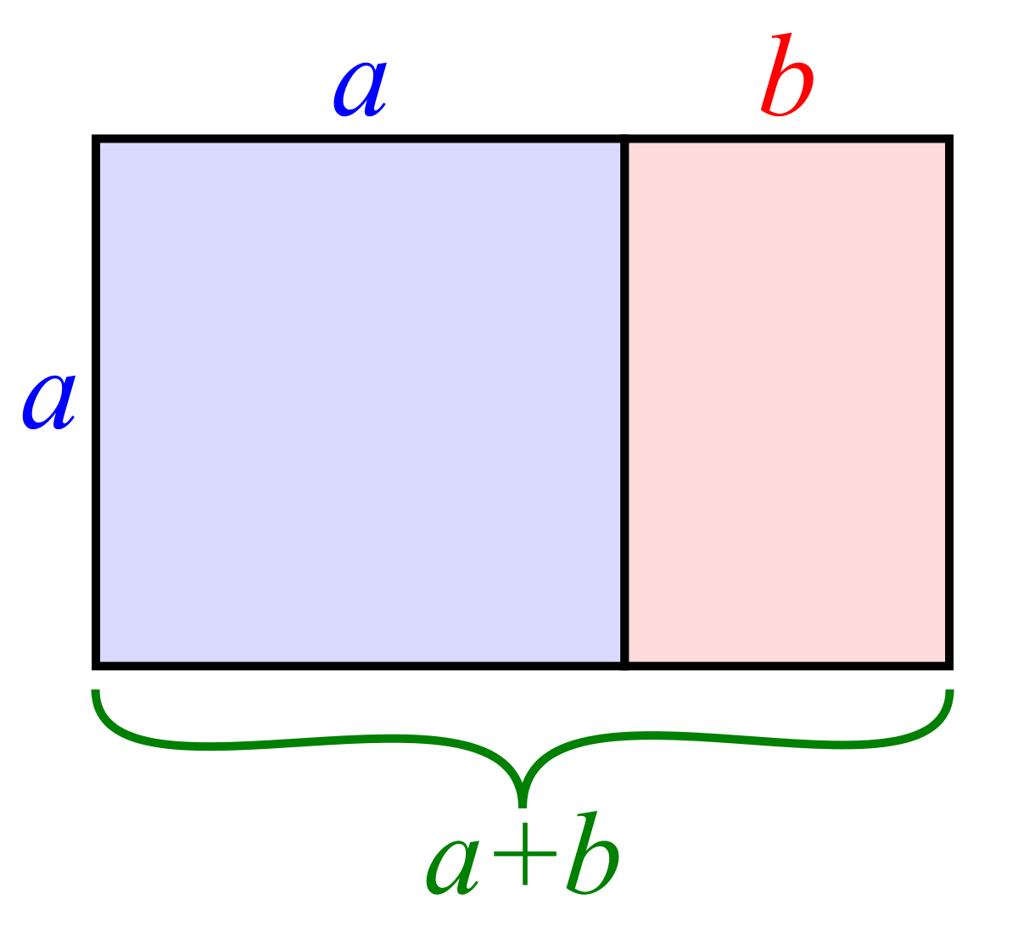
Golden Rectangle

Slide 18
Link to the Fibonacci Sequence [Kepler]
1 1 2 3 5 8 13 21 34 55 89 144 …
Ratio between successive terms
1 2 1.5 1.6666 1.6 1.625 1.615 1.619 1.617 1.618 1.618 …
Rapidly approaches the Golden Ratio

Slide 19
nth Fibonacci number is given by

Slide 20
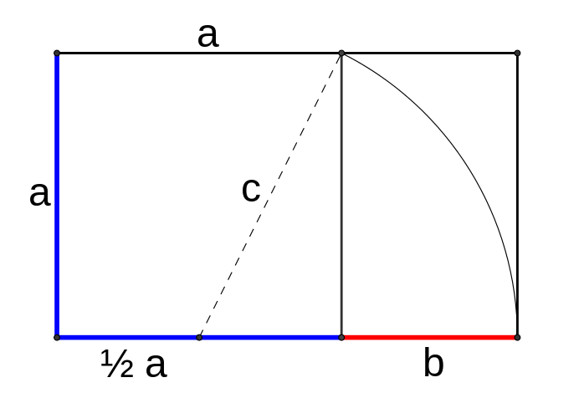
More Geometry
Ruler and compass construction of the Golden Ratio

Slide 21
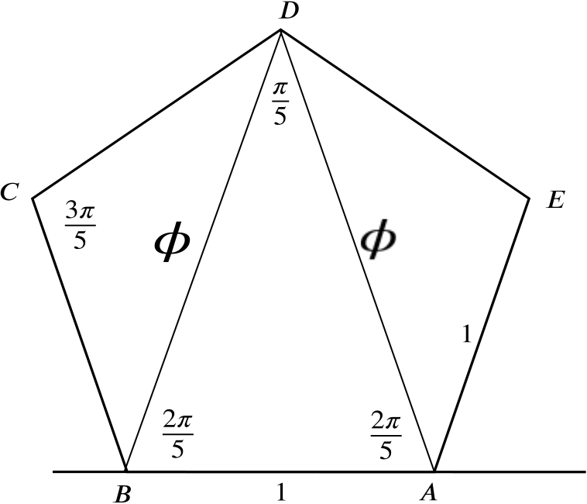
Link to the Pentagon

Slide 22
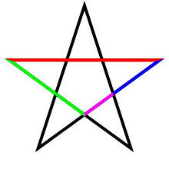
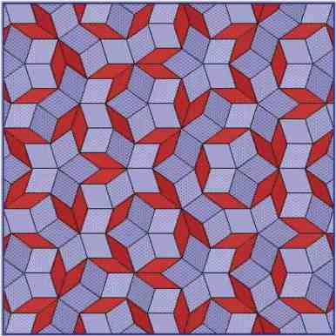
The Pentagram and Penrose Tilings

Slide 23
Irrationality of the Golden Ratio
There are no integers m and n such that

Slide 24

So .. Does the the Golden Ratio play a ‘central role in mathematics’?
NO!!! This is a myth
As a number it is only in the Championship League

Slide 25
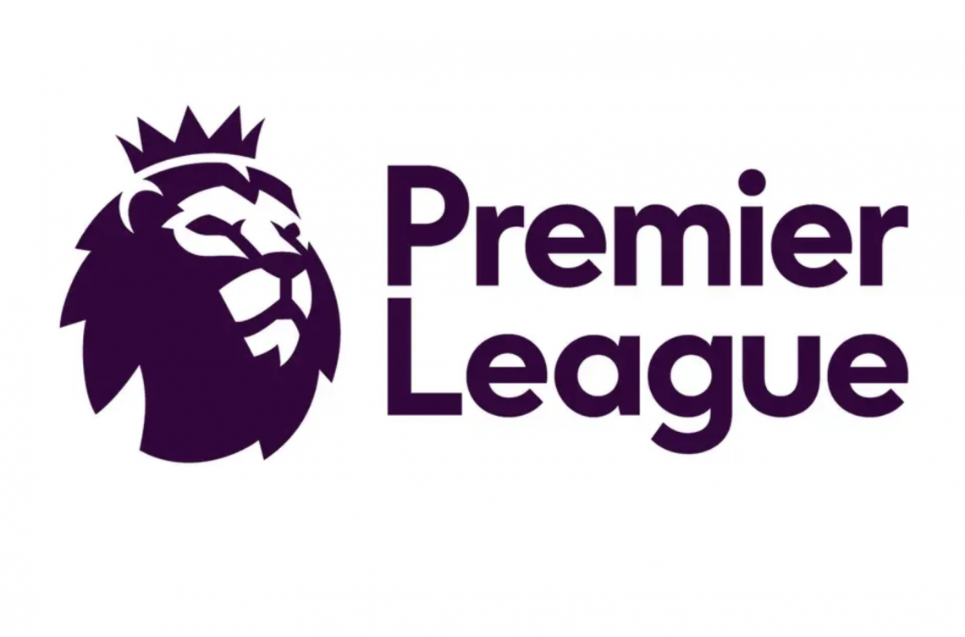
Numbers

Slide 26
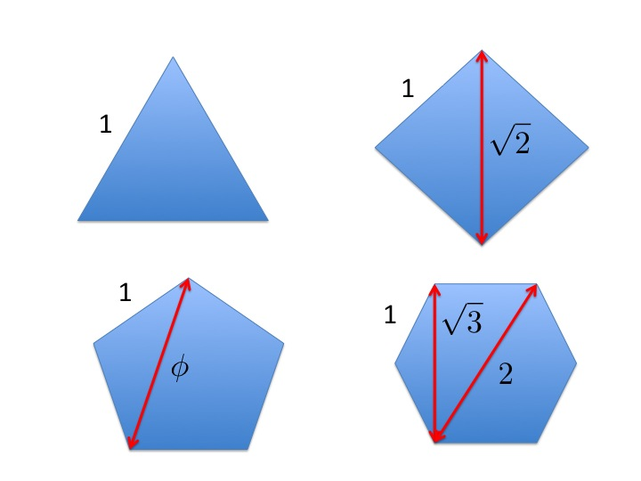
Bottom of the Premier league

Slide 27
Top of the Premier league

Slide 28
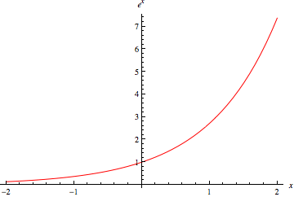
Exponential growth

Slide 29
Practically every formula in science and engineering involves e, or pi or a
combination of the two
In my own work I use these two numbers
all the time
I have used the Golden Ratio exactly twice

Slide 30
Other great numbers
0, 1, -1, i
The most important formulae in mathematics
No sign of the Golden Ratio here!

Slide 31
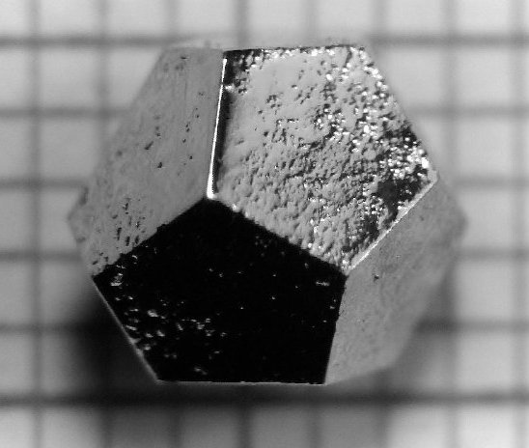
Links of the Golden Ratio to Nature
The truth
The Golden Ratio appears in
nature when there is five-fold
symmetry
Eg. Quasi crystals

Slide 32
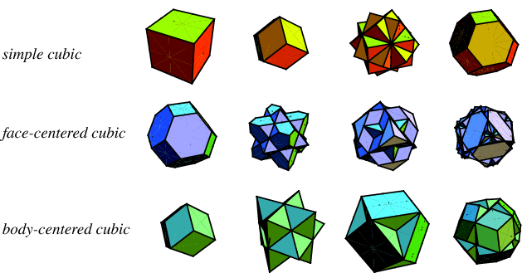
However these crystals are rather uncommon compared to cubes and hexagons which involve the square roots of 2 and 3

Slide 33
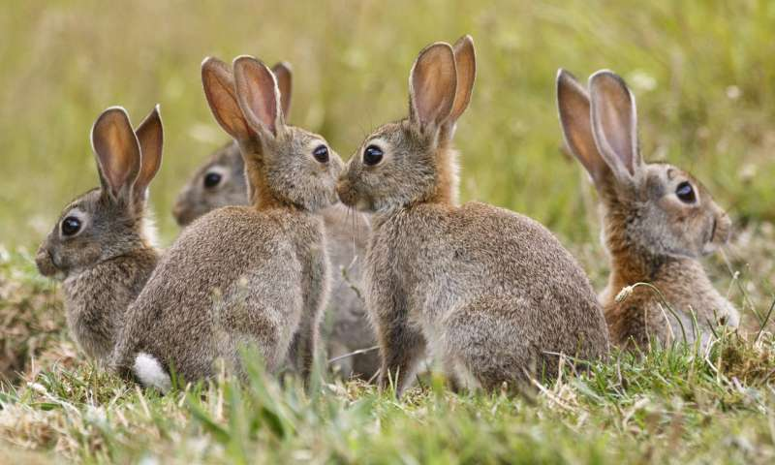
The Golden Ratio is linked to the Fibonacci sequence
This arises naturally in studies of population growth
and also the way that objects pack together

Slide 34
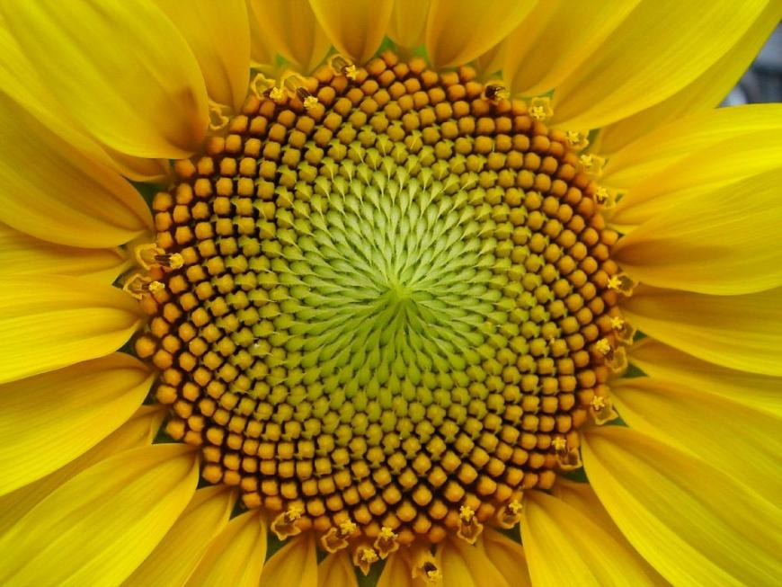
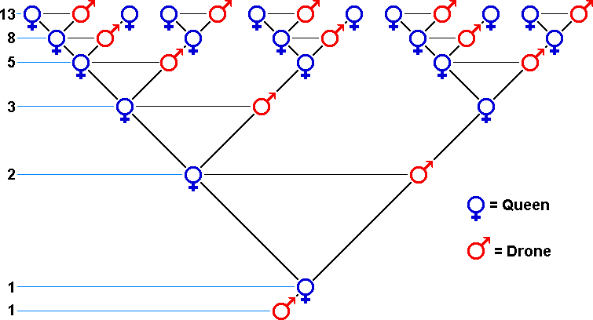
Spirals in a sunflower
Drone bees in a bee hive

Slide 35
The myth

Slide 36
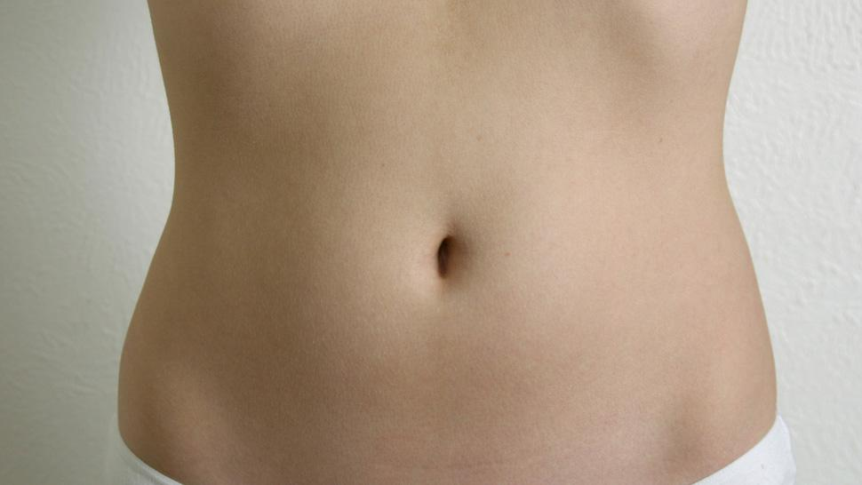
Much much more is claimed of the Golden Ratio
Supposed to be at the heart of many of the proportions in the human body.
Eg. ratio of the height of the navel to the height of the body

Slide 37
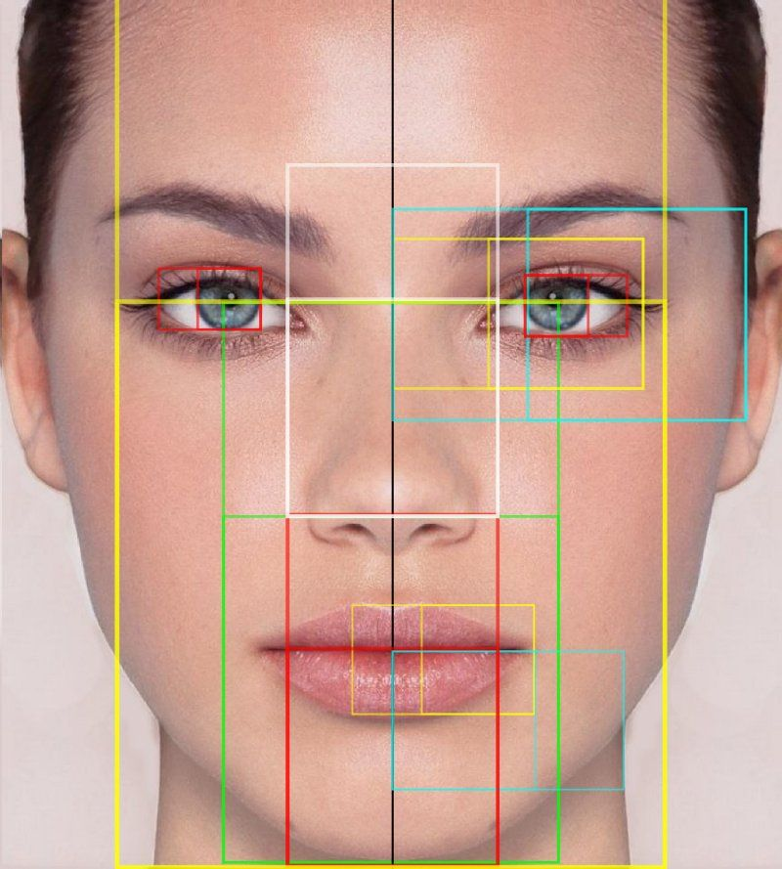
Just about every proportion
of the perfect human face

Slide 38
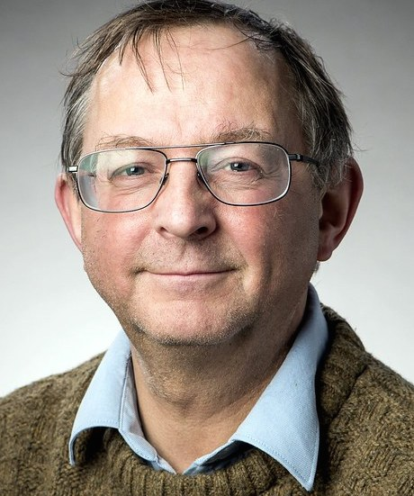
However, none of this is true, not even remotely !!!

Slide 39
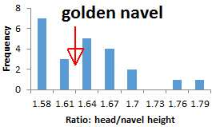
The human body has lots of ratios between 1 and 2
Some by chance are ‘close’ to the Golden Ratio
Many are not

Slide 40
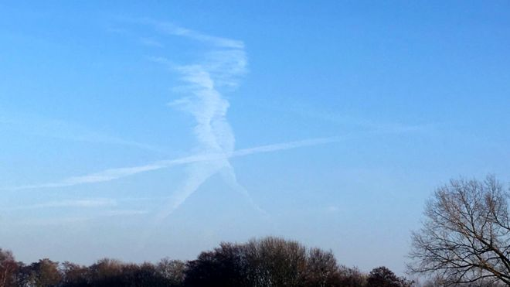
Tendency of the human brain to look for patterns

Slide 41
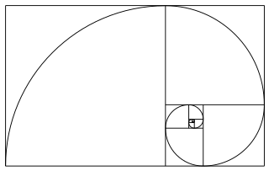
Spirals, Golden and otherwise
Golden spiral …. It’s not a spiral!

Slide 42
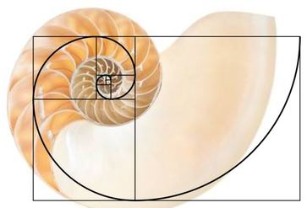
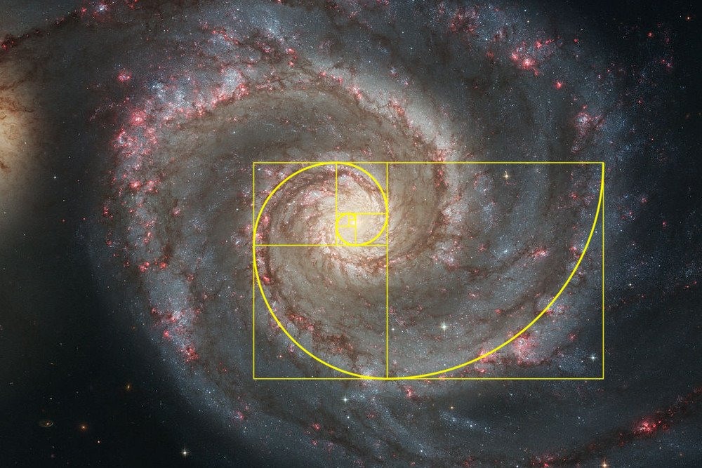
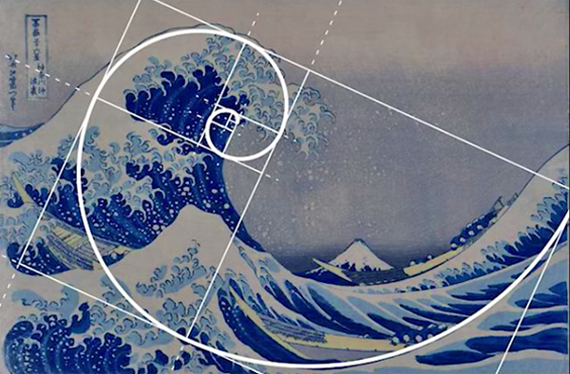

Slide 43
Logarithmic Spiral
Very common in nature
Because of … Self-similarity
If you rotate the spiral by any fixed angle then you get a spiral which is a rescaling of the original

Slide 44
a and b can be any value!!
Golden Spiral
Nautilus:

Slide 45
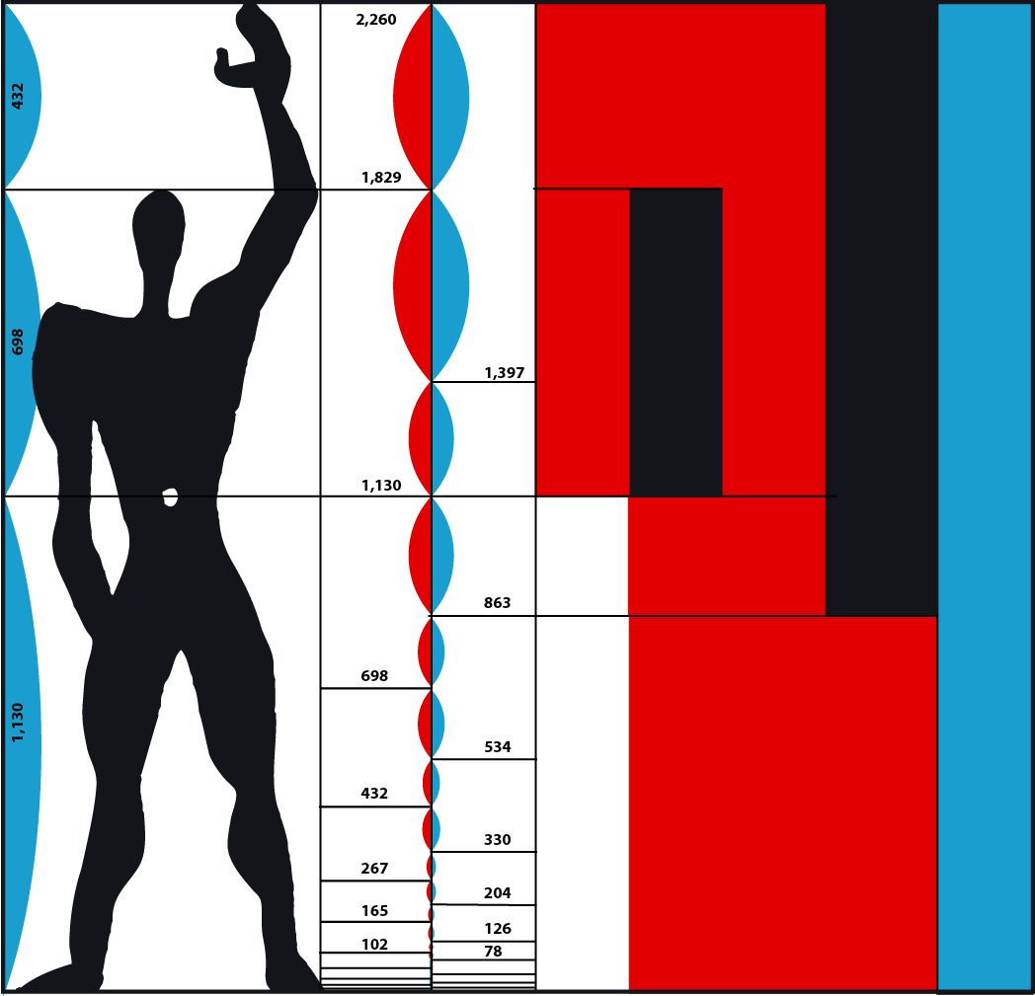
The Golden Ratio in Art
The truth: Some artists eg. Le Corbusier have consciously used the Golden Ratio
The myth: The Golden Rectangle is supposed to be the most aesthetically pleasing rectangle
This has been tested. There is no evidence for it

Slide 46


Slide 47
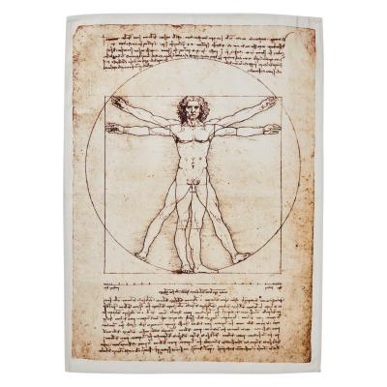
Claimed da Vinci used the
Golden Ratio in his art
No direct evidence of this!
da Vinci only mentioned whole
number ratios
Famous example: Vitruvian Man
But its proportions do not match the Golden Ratio
Examples of finding the Golden Ratio in his pictures are in the same class as finding the ratio in the face

Slide 48
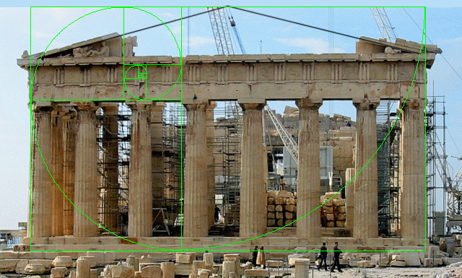
The Parthenon
No evidence of the use of the ratio in Greek scholarship
Idea the Parthenon has proportions given by
the Golden Ratio only dates back to the 1850s

Slide 49
The real truth is much better than the myth
The Golden Ratio is the most irrational number
z any number m/n a fraction
error of approximating z by a fraction

Slide 50
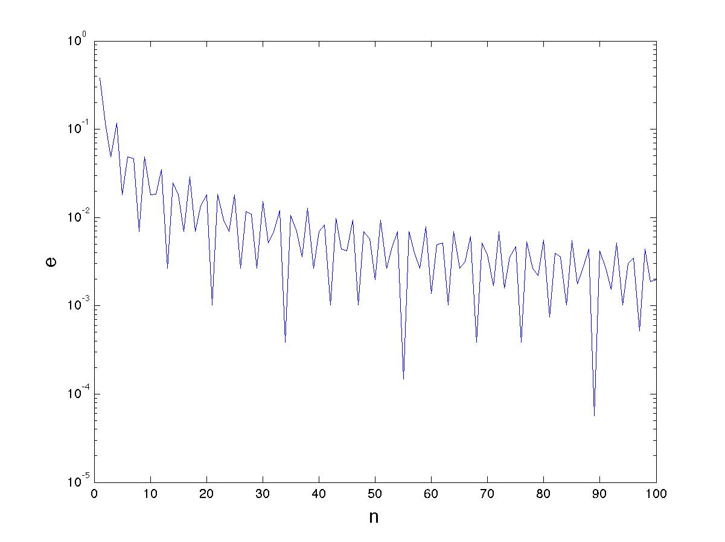
5
8
13
21
34
55
89

Slide 51
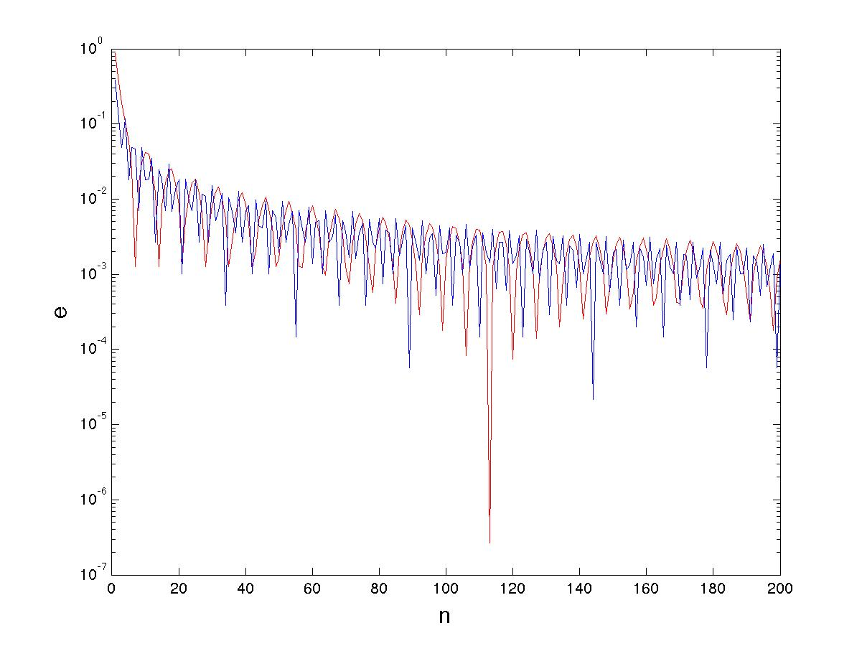

Slide 52
Hard to approximate
Easy to approximate

Slide 53
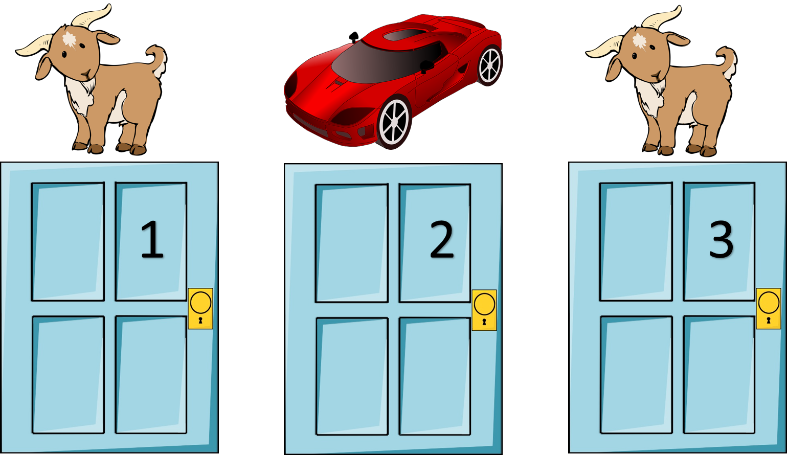
The Monty Hall Problem

Slide 54
Contestants on the game show are shown three shut doors
Behind one is a car Behind the other two is a goat
Asked to choose a door and to tell the host
The host opens a different door to reveal a goat
Given a choice
Stay with the chosen door or swap
The door they choose is opened

Slide 55
Should you change your
door or not?

Slide 56
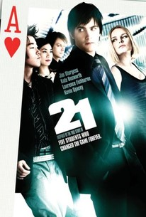
Often quoted answer is YES!
But this isn’t always correct

Slide 57
Answer depends completely on the knowledge of the host and contestant
Case 1: Knowledgeable host, ignorant contestant
Chance contestant chooses a car is 1/3
Knowledgable host will always reveal the goat
so no new information
Chance the other door is a car is still 2/3
Double your chances by changing doors

Slide 58
Case 2: Ignorant host, any contestant
Contestant chooses a door
Host shuts their eyes and opens a door. It’s a goat
Changes the information in the problem
Bayes’ theorem says that the chance of the contestant having a car is now ½
No reason to change

Slide 59
Case 3: Knowledgeable host, knowledgeable
contestant
Contestant chooses a car. Host reveals goat. Contestant changes their door. They get a goat!
Contestant chooses a goat. Host asks them to choose another door, and then choose whether to swap doors. They swap and get a car with probability ½
Overall they only get a car with probability 1/3

Slide 60
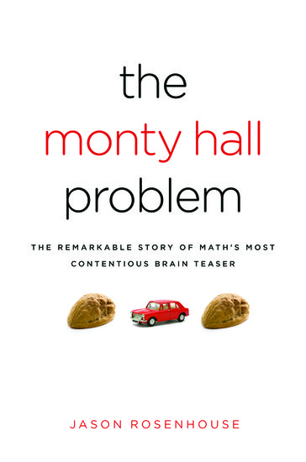
A little knowledge is a dangerous thing
Rob Eastaway

Slide 61
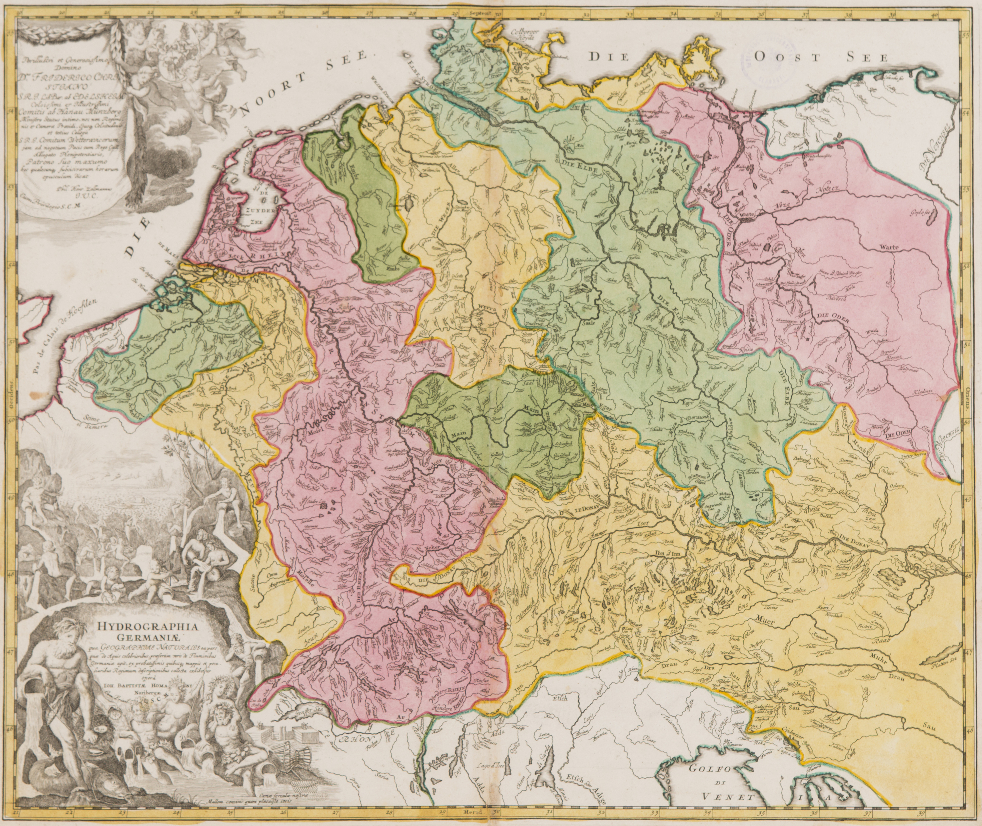
The Four Colour Theorem
Want to colour a map as cheaply as possible

Slide 62
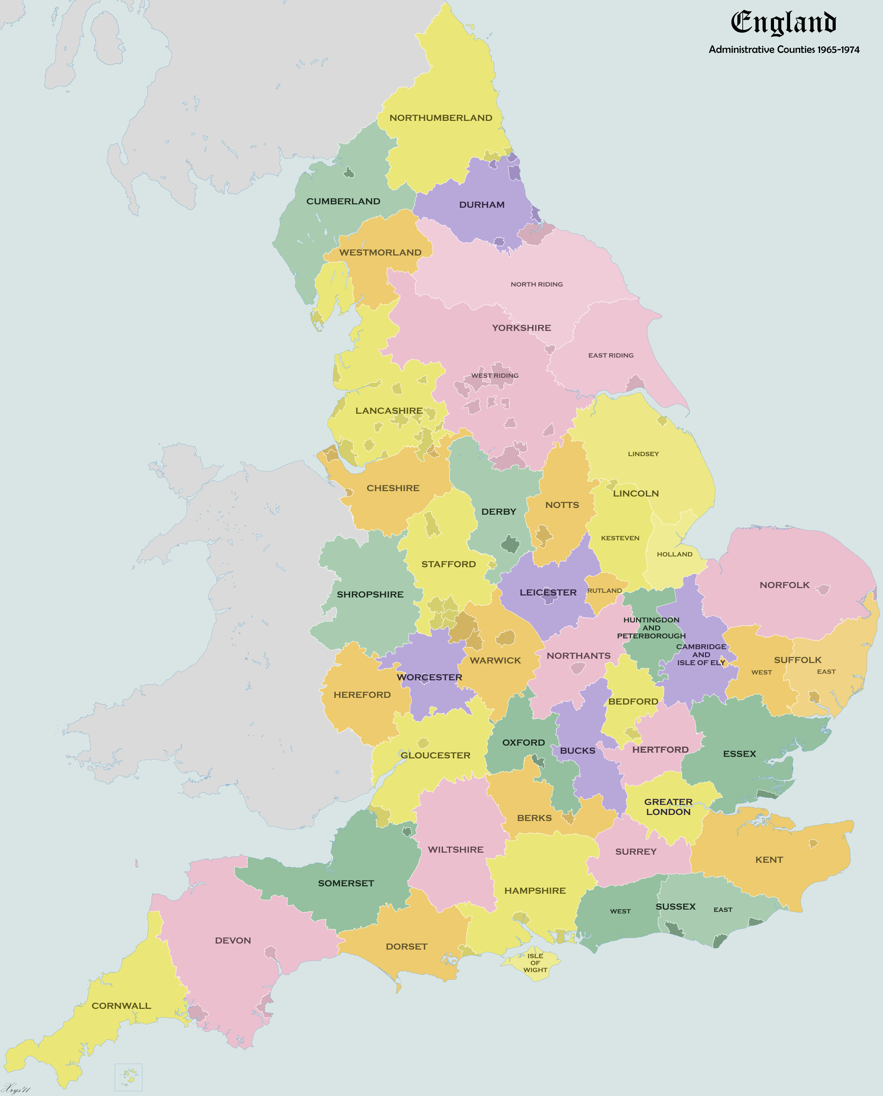
Rules
Each country must have
one colour
2. Two countries which
have a common border
must have different colours
Q. What is the smallest number of colours needed?

Slide 63
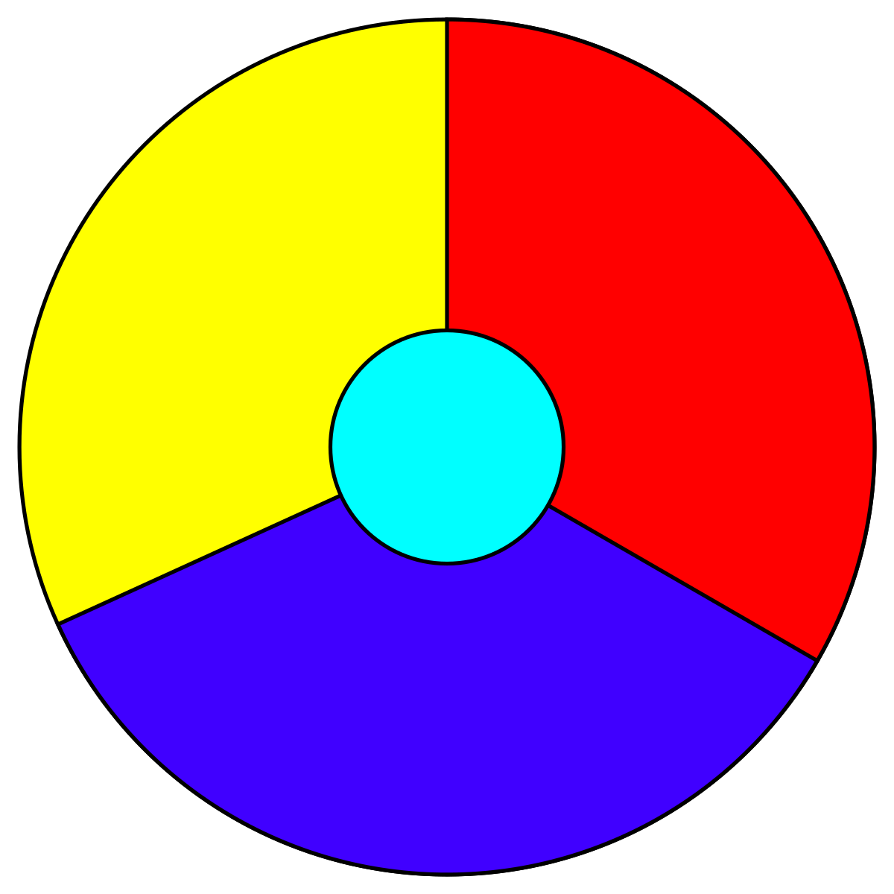
Must have at least four colours

Slide 64
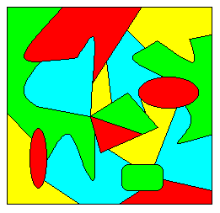
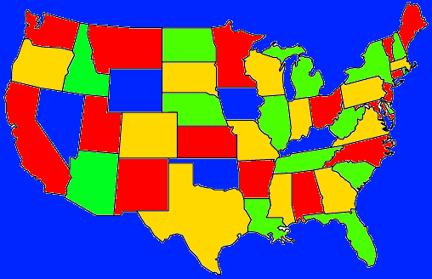
Found ‘empirically’ that only four colours seemed to be needed
Conjecture proposed in 1852 by Francis Guthrie, who was trying to colour the map of counties of England

Slide 65
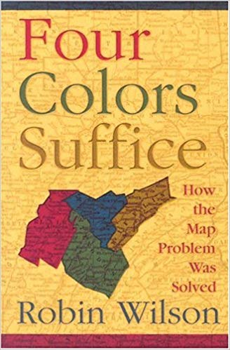
‘Proof’ in 1879 by Kempe
Shown to be wrong. But became the
‘five colour theorem’
Resisted proof for 100 years
1976 the four colour theorem
was proved by
Kenneth Appel and Wolfgang Haken
Proof was ‘by computer’ and was
Very controversial

Slide 66

Now a very important result in communications technology

Slide 67
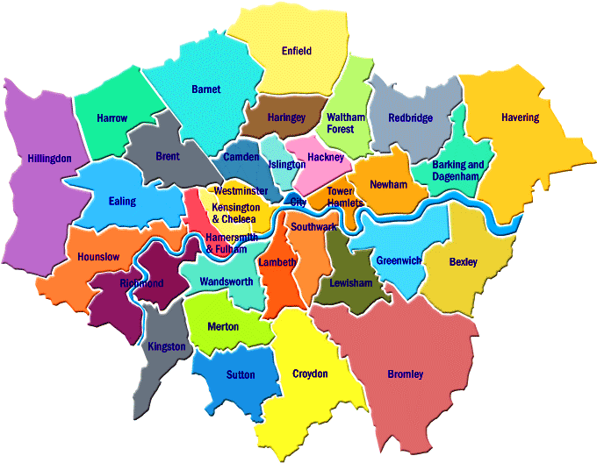
The Truth
The four colour theorem applies to all non contiguous planar graphs
The Myth
It works for maps
It doesn’t!

Slide 68
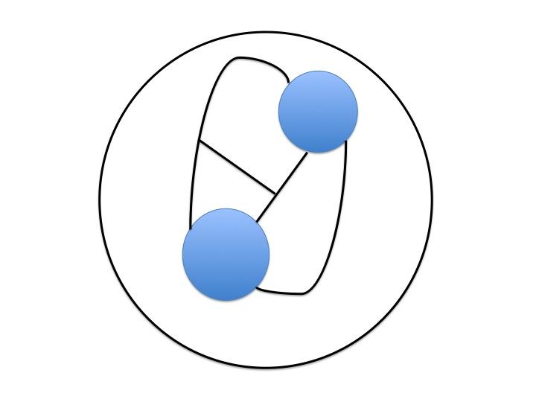
A map which cannot be coloured with four colours
Lake Gresham
2
4
1
3
Lake Geometry

Slide 69
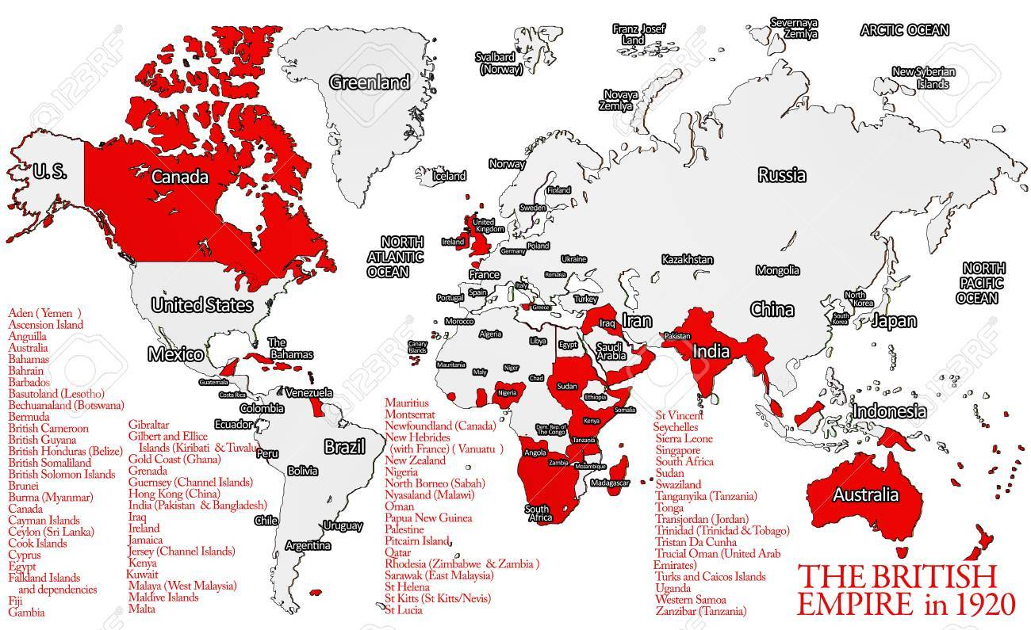
Problem: The sea is always blue
Empires can be red
Maps like this often need more than four colours

Slide 70
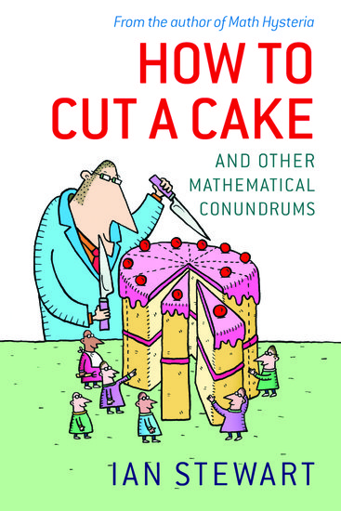
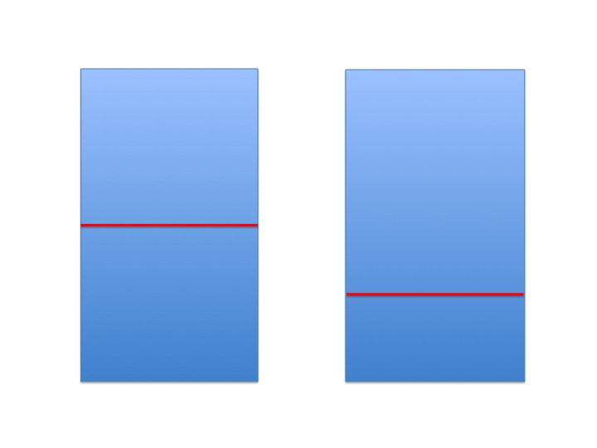
Cutting a cake
How do you cut a cake fairly?
Fair cut Unfair cut

Slide 71
The Myth: The I cut, you choose, method
One party divides up the cake
The second party then has the first choice
Reasoning: it is clearly in the interests
of the first party to cut the cake as fairly as possible
Then, no matter how the second party choses, the remaining piece will be as close to ½ of the original as it is possible to get

Slide 72
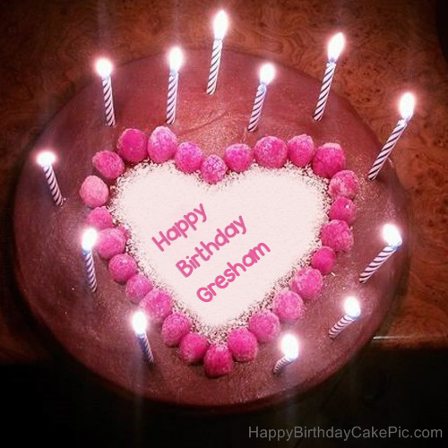
Problem:
This method gives an
overwhelming advantage to the person who choses first
A much better method is to use iteration
This is how a computer would do it

Slide 73


First Cut
Second Cut

Slide 74

Continue with the new piece till only the crumbs are left

Slide 75
A mathematician named Hall,
Once went to a fancy dress ball,
They thought they would risk it,
And go as a biscuit,
But a dog ate them up, crumbs and all.

